Slide 1
FISH270
Lec 18

Slide 2
Case Studies

Slide 3
Ocean Acidification
-
Disease Resistance

Slide 4
Recap on OA studies

Slide 5
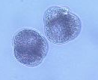
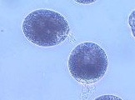
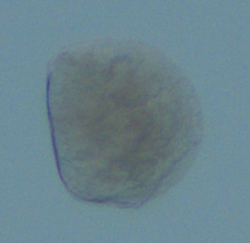
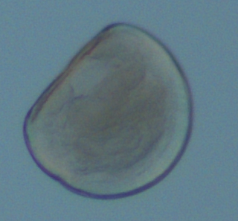
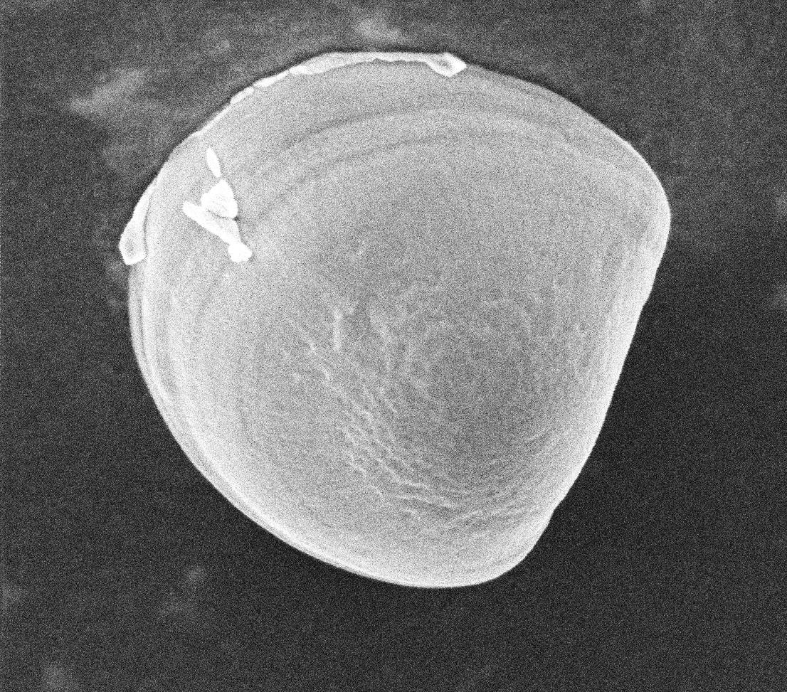
Experimental Design
Equilibrate treatment water
Fertilization
1 hpf
6 hpf
24 hpf
72 hpf
96 hpf
Fix samples for developmental stage, size, and calcification
Notes:
An example of investigating the effects of elevated pCO2 on larval Pacific oysters

Slide 6
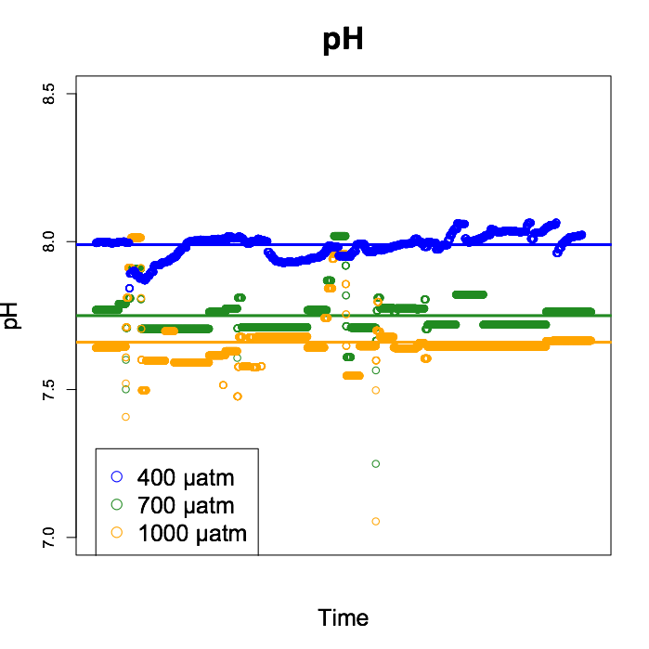
Notes:
Average pH was separate for the 3 treatments: 400 µatm (Ambient, pH ~8.0), 700 µatm (MidCO2, pH~7.8), 1000 µatm (HighCO2, pH ~7.65)

Slide 7
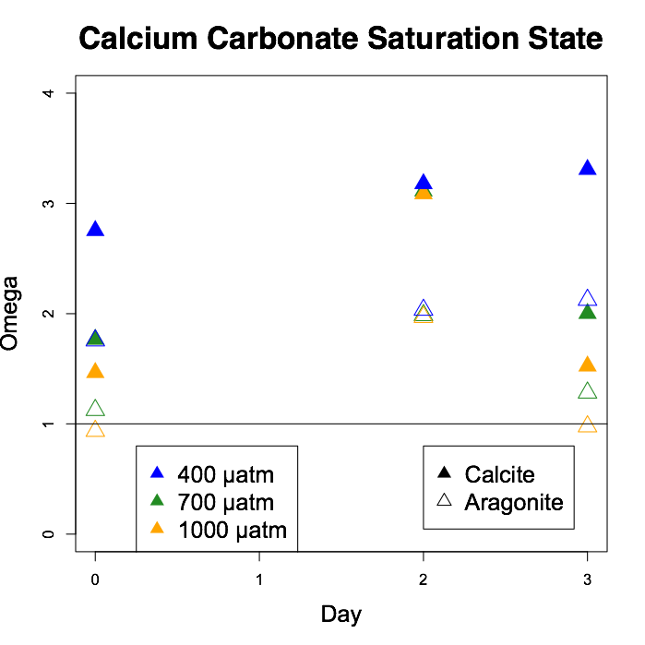
Dissolution
threshold
Notes:
The “dissolution threshold” at 1 means that it becomes thermodynamically difficult to make/maintain shell.
Aragonite saturation (open triangles) is always lower than calcite (closed) because it is more soluble
Only 1000 µatm crosses below the threshold

Slide 8
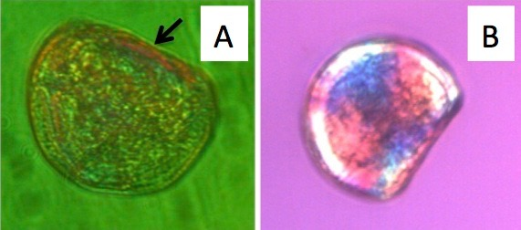
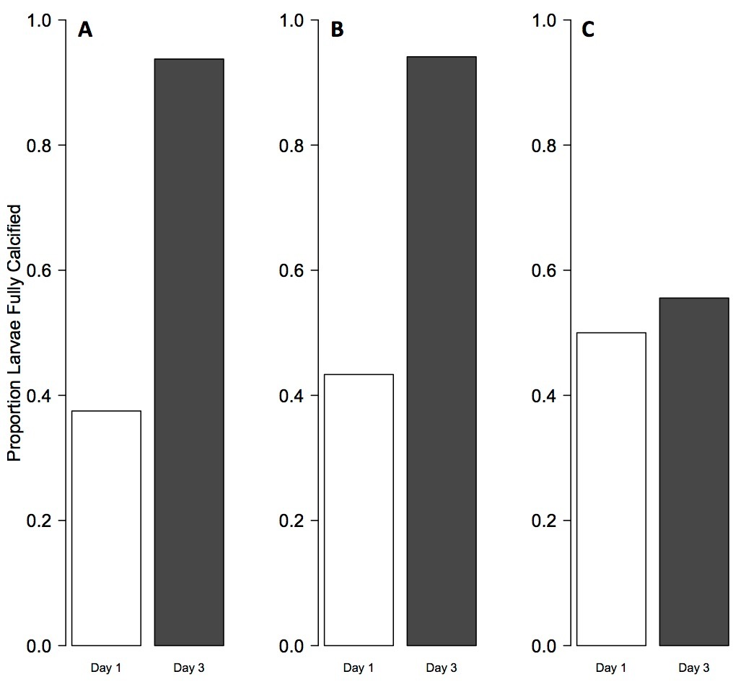
Timmins-Schiffman et al. 2013
Notes:
Calcification is measured using polarized light. The polarized filter makes the CaCO3 shine.
On day 1 (green larva) calcification = CaCO3 at the hinge; this is the beginning of calcification
On day 3 (pink larva) calcification = maltese cross on the shell, fully shiny
Significantly more larvae at highCO2 had calcified material on day 1, but on day 3 significantly fewer at highCO2 were fully calcified

Slide 9
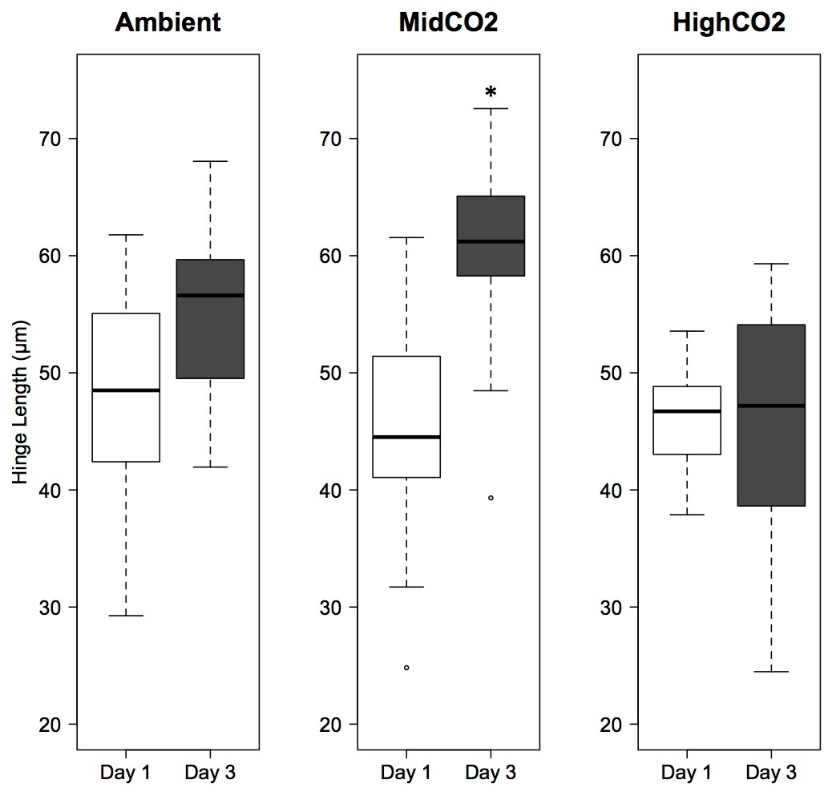
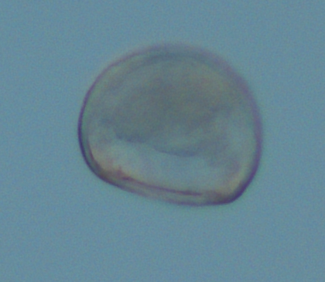
Timmins-Schiffman et al. 2013
Notes:
There was no difference in larval size for hinge length (white bar on larval picture) across treatments on day 1. By day 3, larvae at ambient and midCO2 were significantly larger than those at highCO2.
At MidCO2 on day 3 larvae were significantly larger from Day 1

Slide 10
Conclusions
Elevated pCO₂ puts stress on larvae, leading to different allocations of internal energy reserves for metabolic processes
The phenotype associated with these changes is developmental delay
What is the significance of these changes?
Notes:
By delaying development, the larvae could be reserving necessary resources to survive the stress. Interestingly, when there was no difference among treatments (day 1) the larvae were still relying on maternal energy resources. The developmental delay coincides with the larvae switching to feeding on their own. This has also been observed in other species.

Slide 11
prezi-

Slide 12
Immune Response

Slide 13
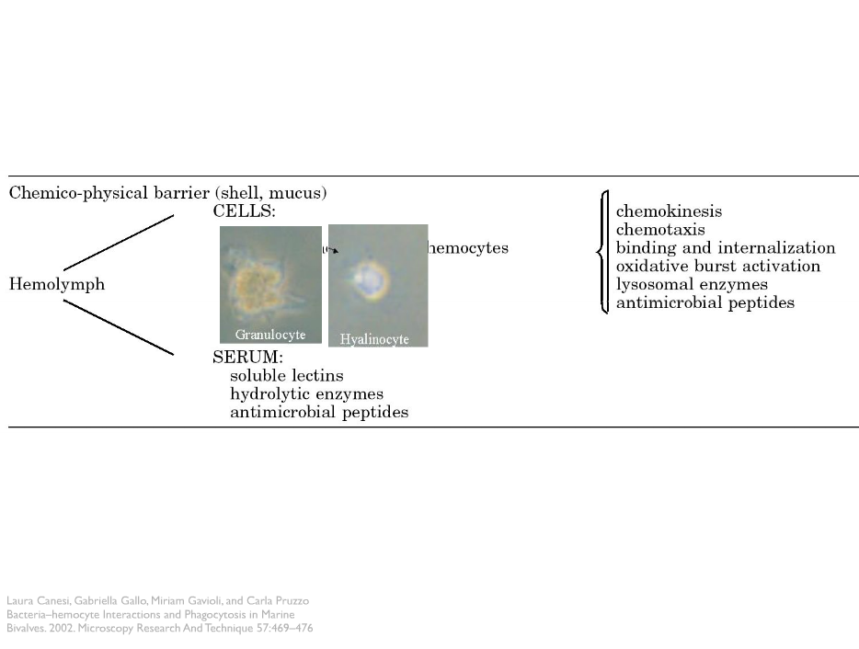
Innate Immunity

Slide 14
Today: Physiological Response to things that are bad
It is important the think about the big picture.
What else is going on with the critter...
really big picture -
What has the population experienced.

Slide 15
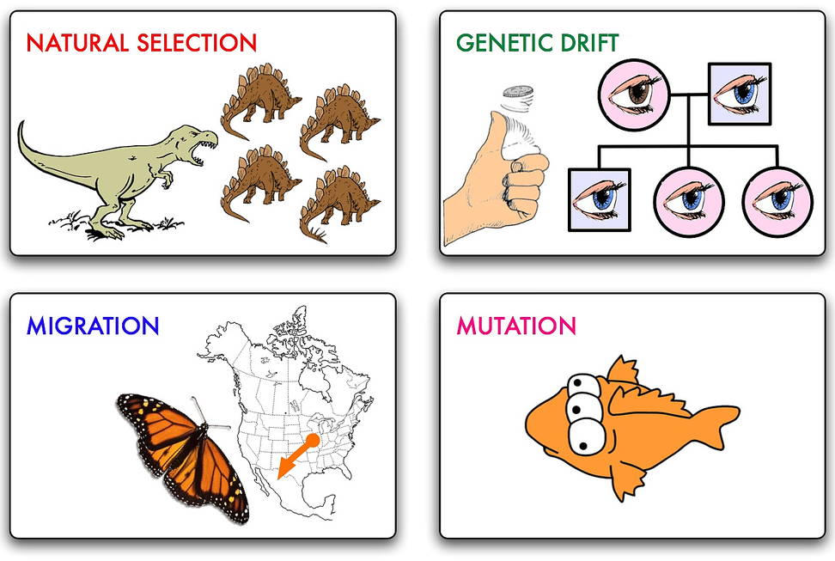

flickr | cpurrin1

Slide 16
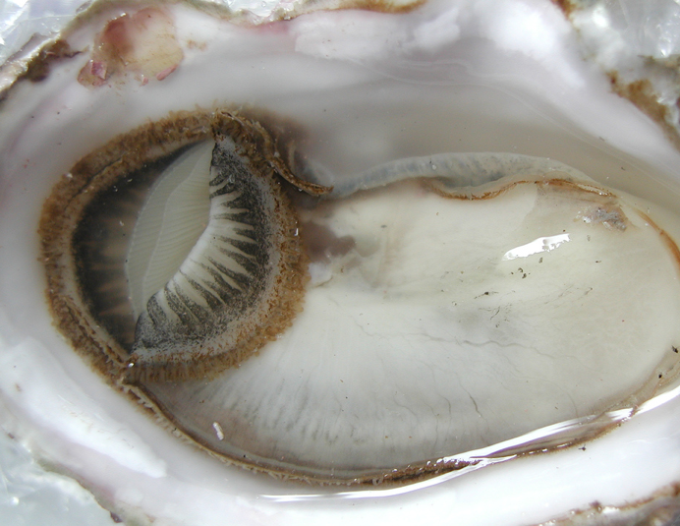
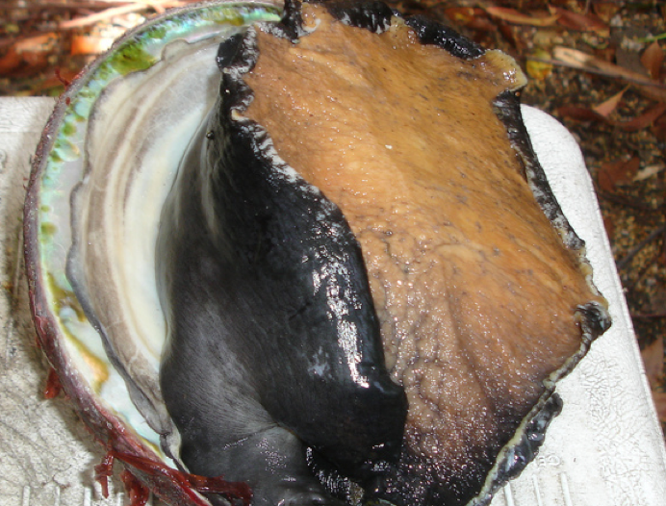
Two part story

Slide 17
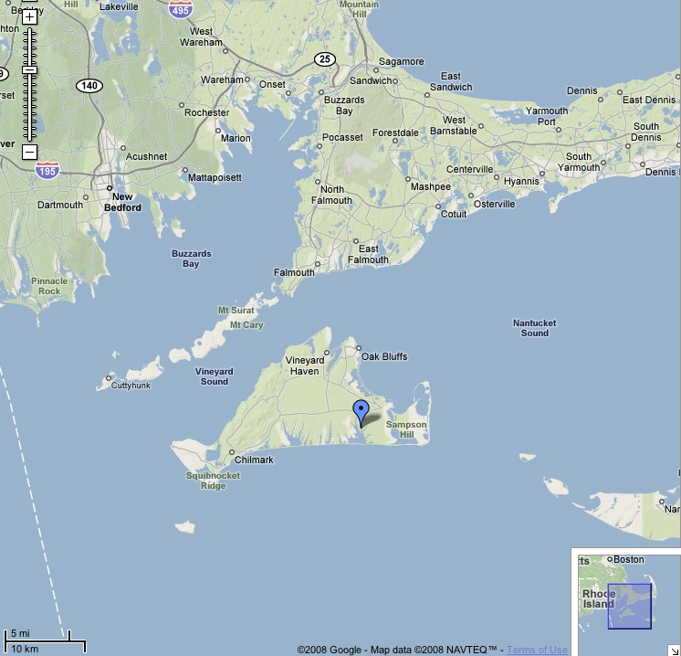
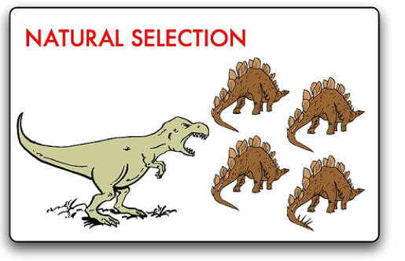
MVineyard
flickr | cpurrin1
Roxannna Smolowitz
Rick Karney

Slide 18
MVineyard
Disease Resistance ?
flickr | cpurrin1
Roxannna Smolowitz
Rick Karney

Slide 19
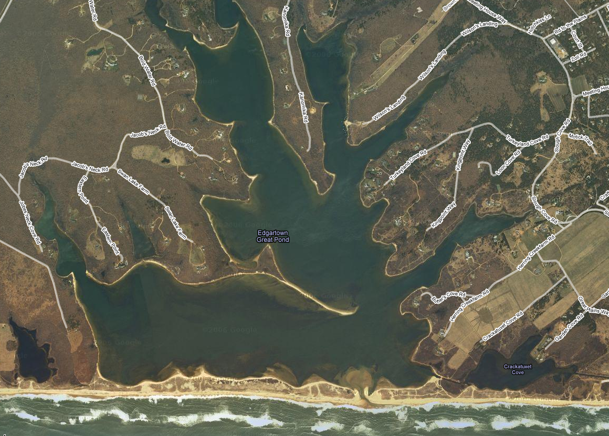

Slide 20
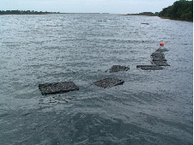

Slide 21
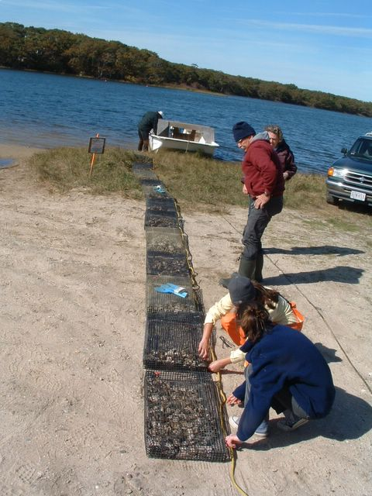

Slide 22
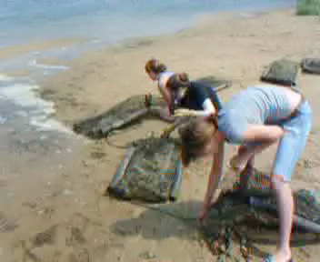
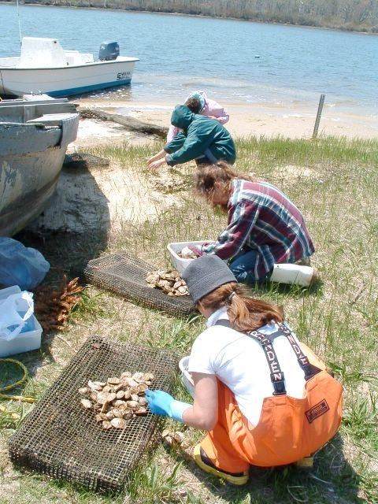

Slide 23
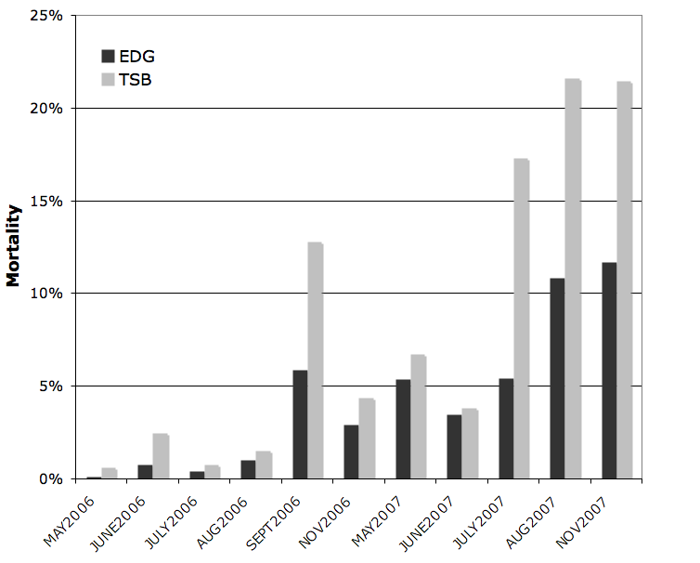

Slide 24
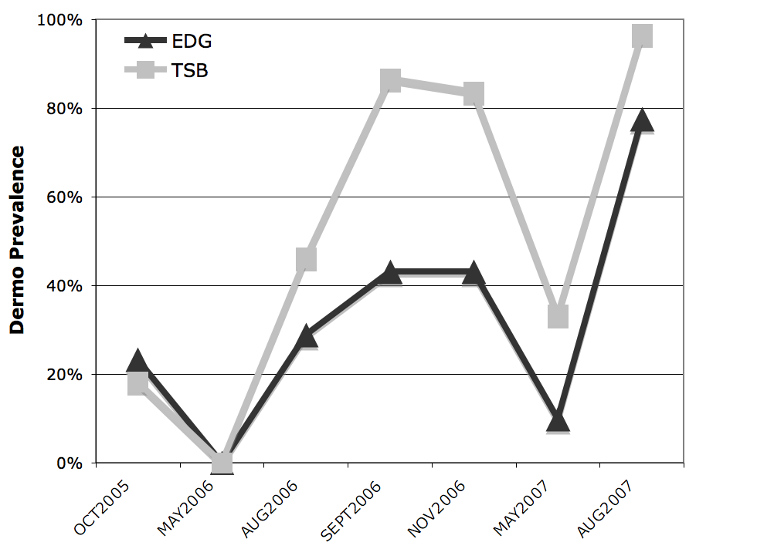

Slide 25
what else could cause the dips

Slide 26
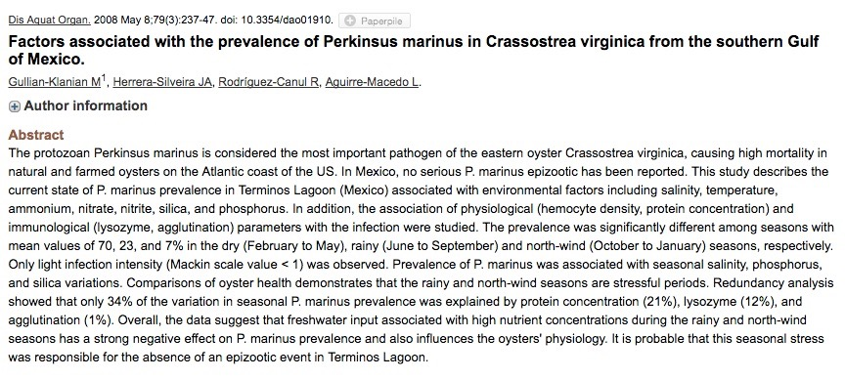

Slide 28
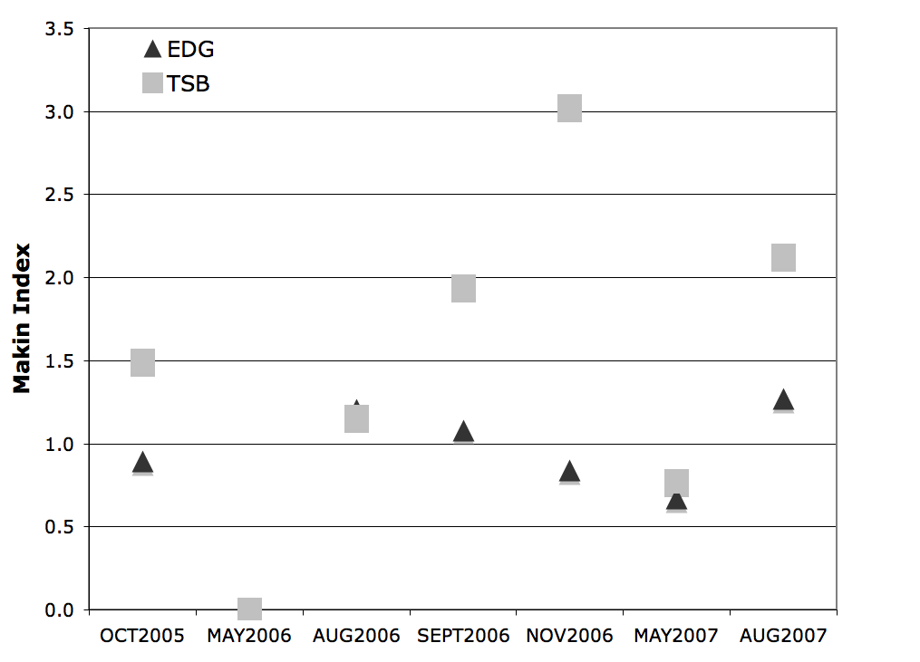

Slide 30
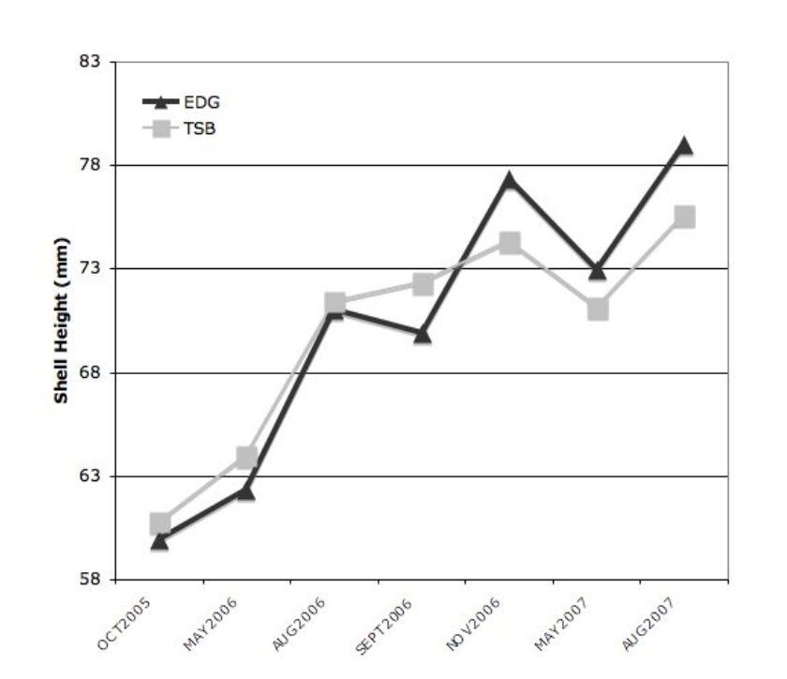
Market size

Slide 31
Mechanisms
They are different,
but how / why?

Slide 32
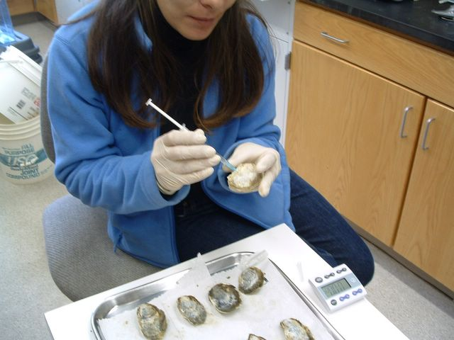
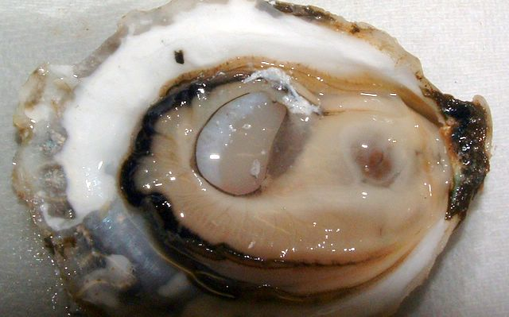

Slide 33
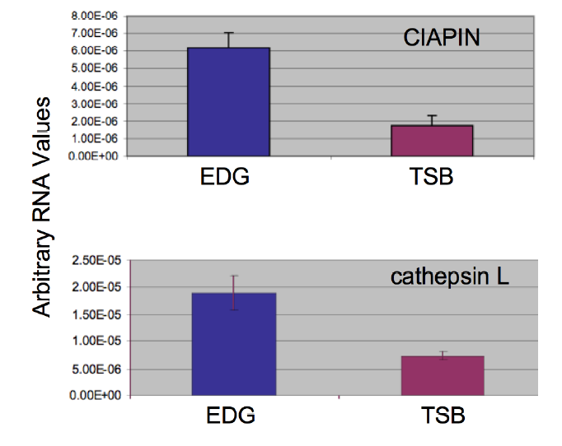

apoptosis
protease

Slide 34
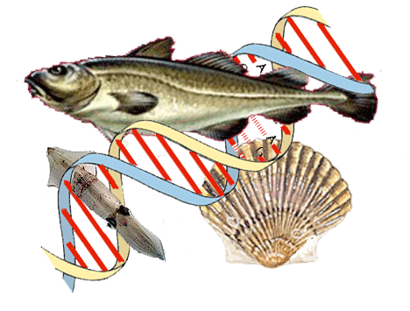
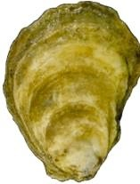
Schematic
Parasite
Hemocytes
Text
BCL-X
BCL-X
Resistant
Wild-type

Slide 35
Apoptosis – BCL-X
Resistant oyster strains could downregulate apoptosis suppression
Allowing for increased apoptosis
Decreasing number of cells available for Perkinsus proliferation

Slide 36
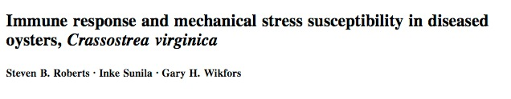
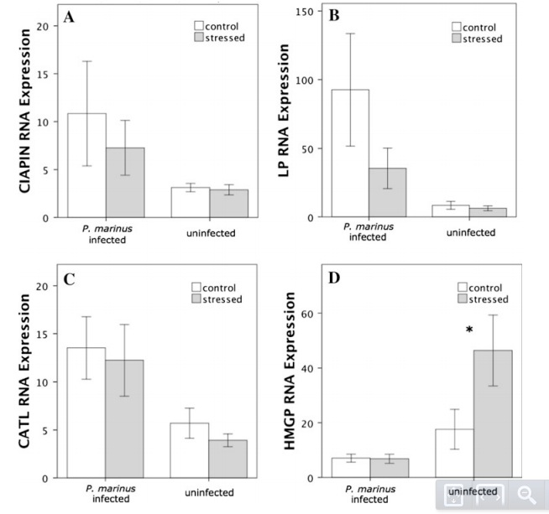
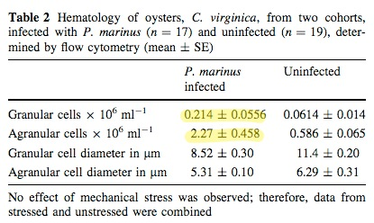

Slide 37
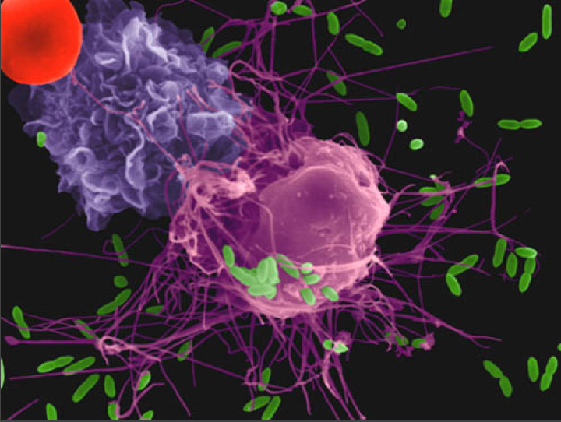
numerous pathways examined
All of these processess are controlled by proteins
proteins are translated from genes.....

Slide 38
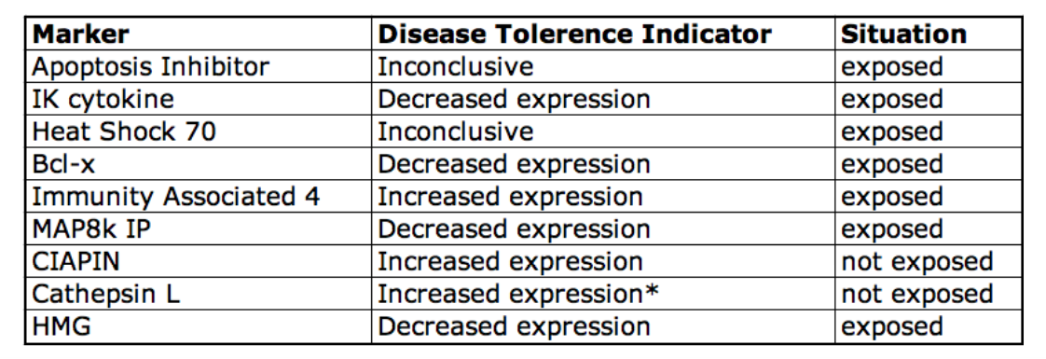
Exploiting observed differences

Slide 39
Schematic
Parasite
Epigenetic?
Hemocytes
Text
BCL-X
BCL-X
Resistant
Wild-type

Slide 40
Summary - Oyster
Offspring of survivors of heavy disease pressure are more tolerant to disease
Mechanisms involved in host responses to P. marinus include proteases and apoptosis

Slide 41
General Observation
on selection

Slide 42
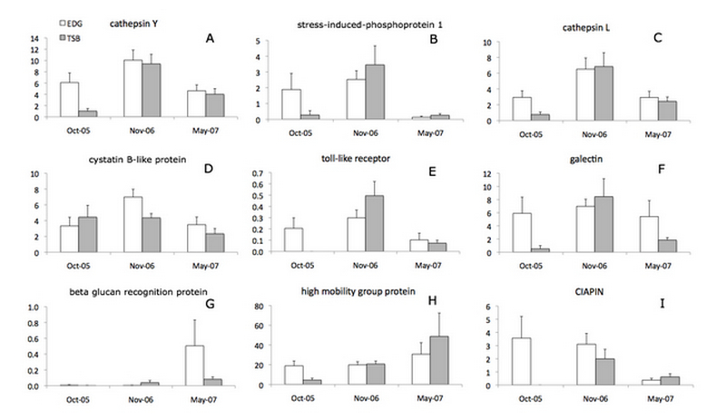

General Observation

Slide 43
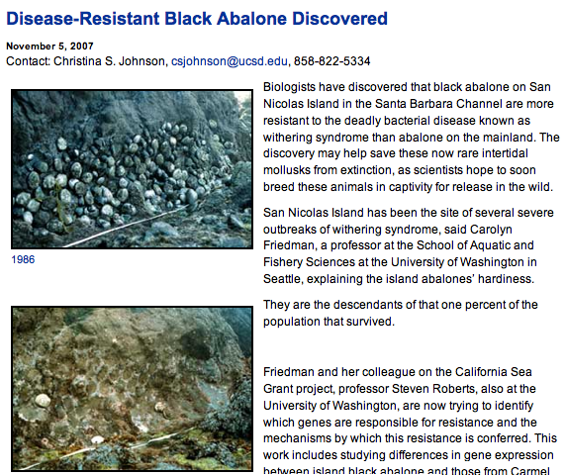
Glenn VanBlaricom, Carolyn Friedman

Slide 44
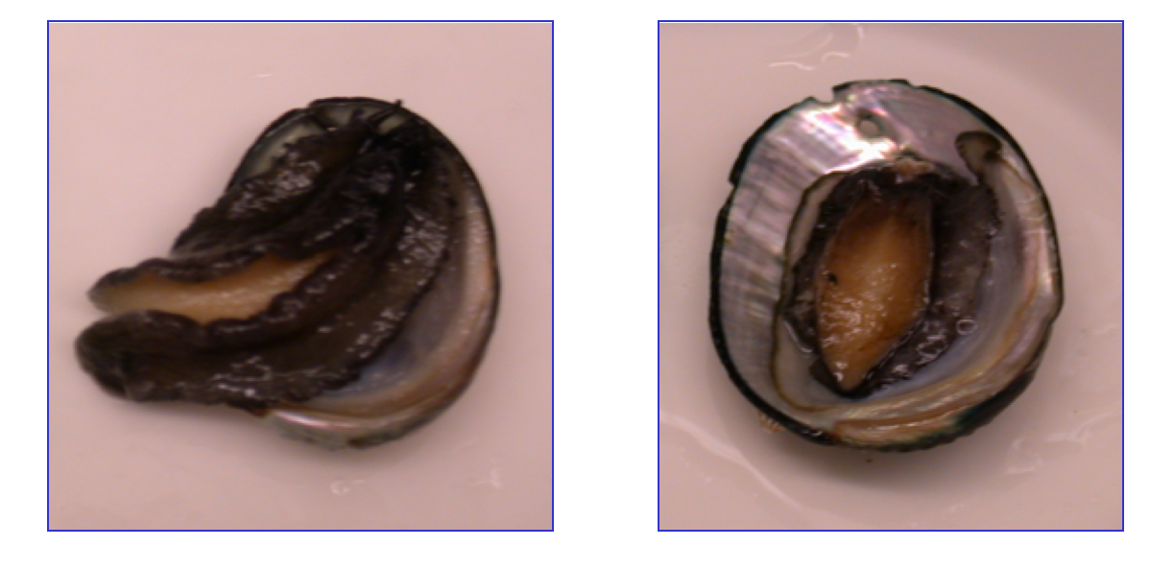
Abalone

Slide 45
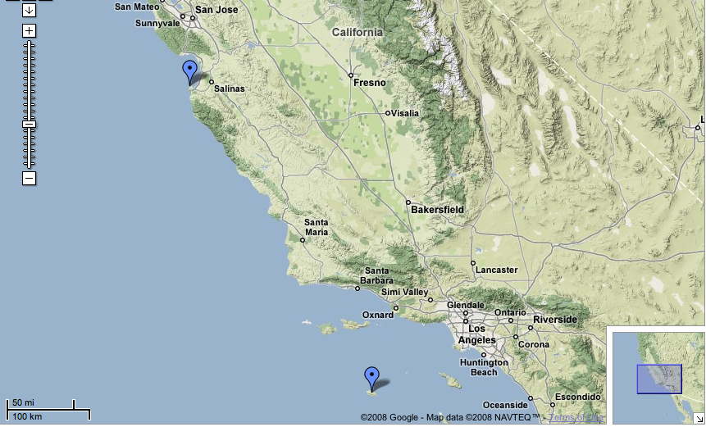
Naive
Disease Pressure
Glenn VanBlaricom, Carolyn Friedman

Slide 46
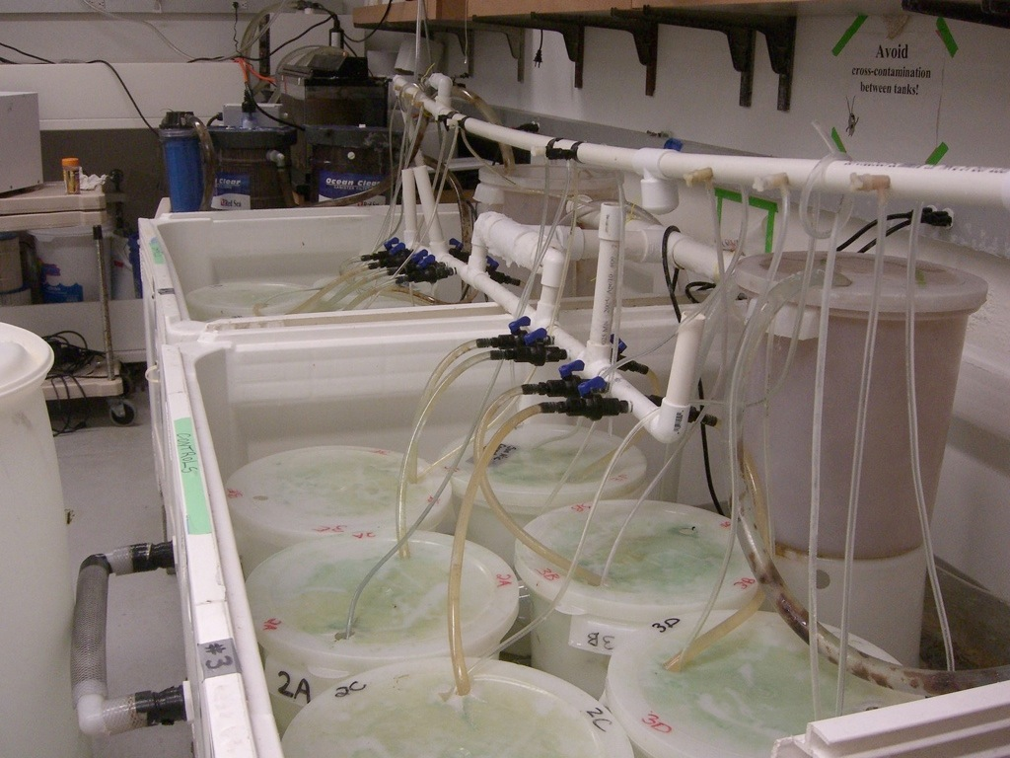
Carolyn Friedman

Slide 47

Carolyn Friedman

Slide 48
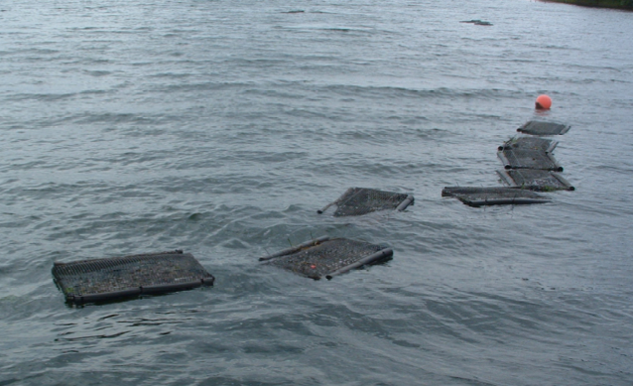
analagous to ...

Slide 49
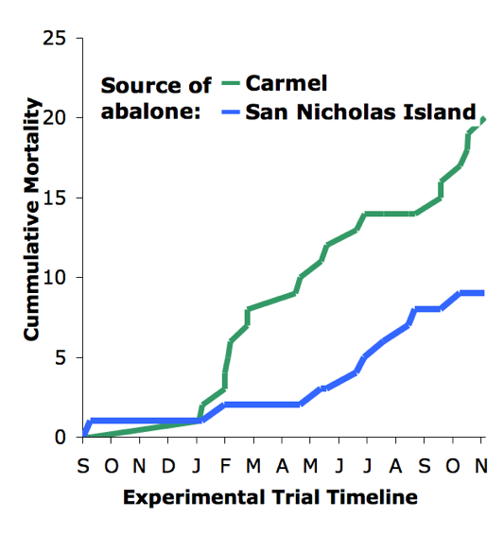

Slide 51
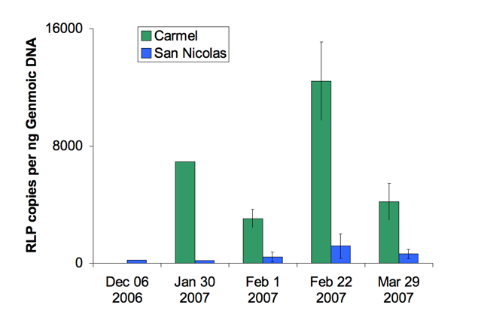

Slide 52
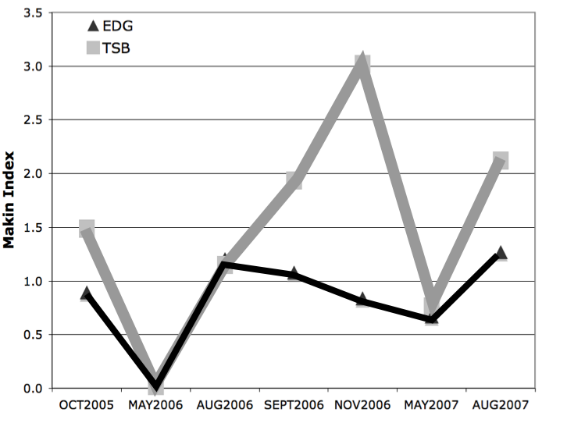

Slide 53
Increased Resistance
Better survival AND less pathogen load
How?

Slide 54
Differences?

Slide 55
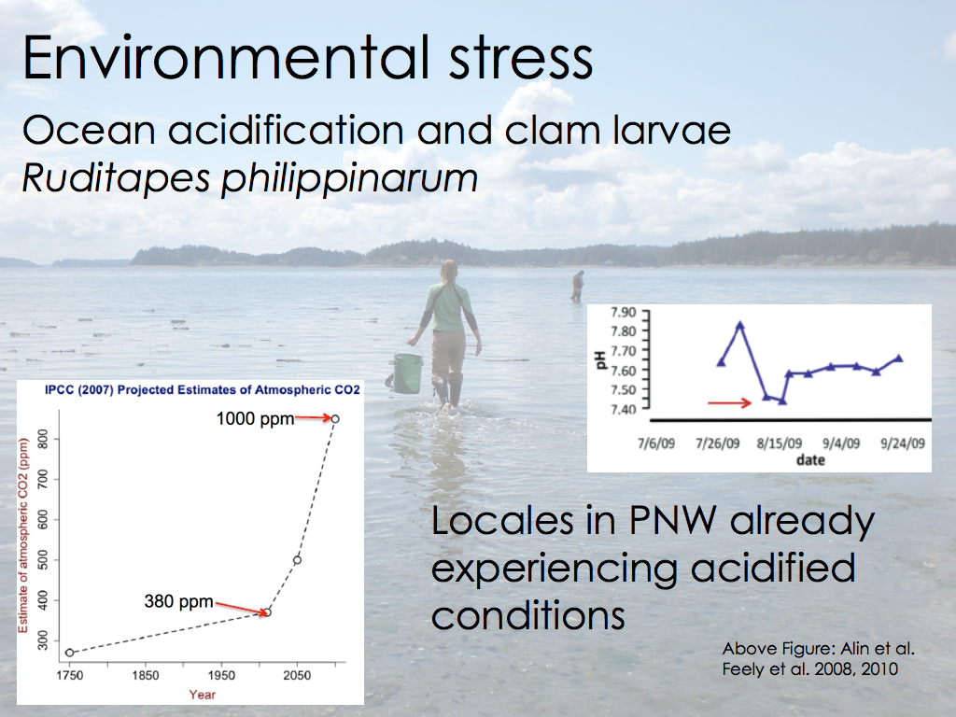

Slide 56
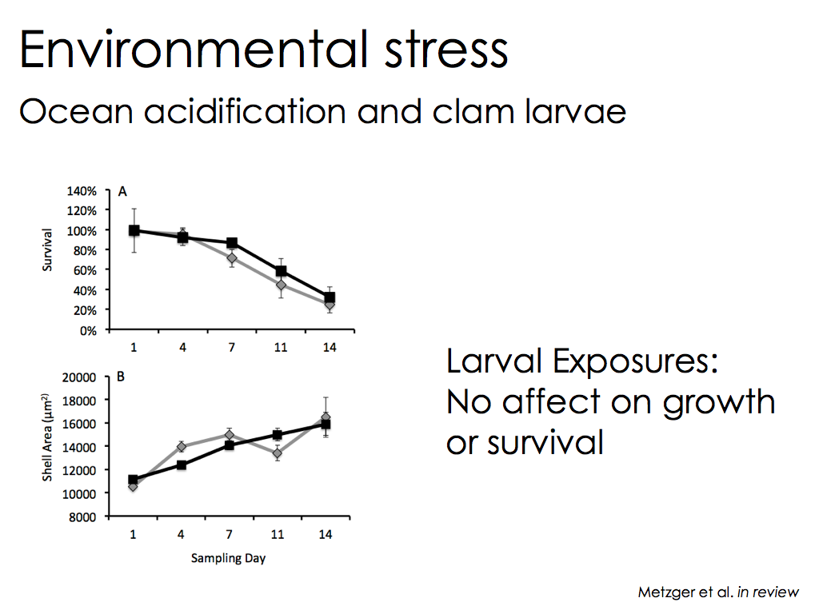

Slide 57
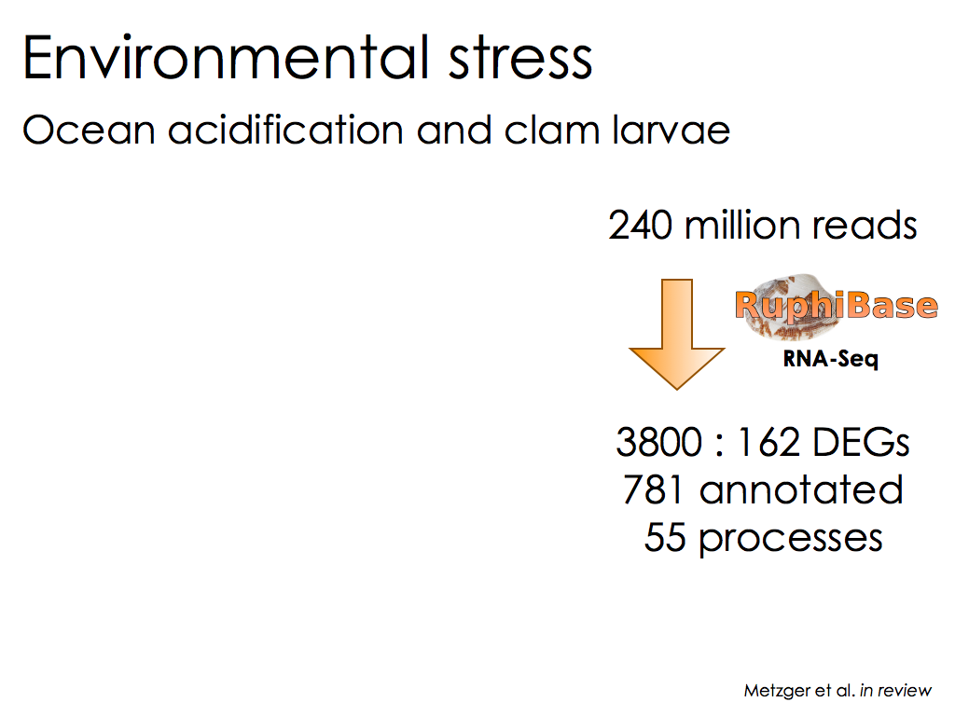

Slide 58
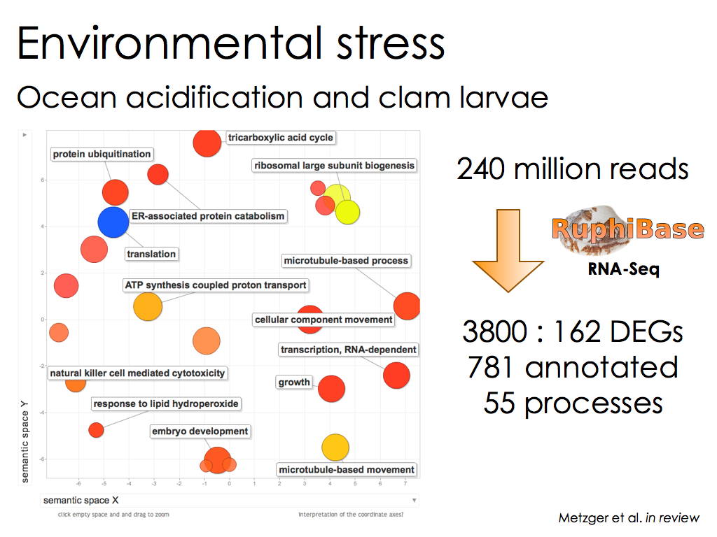

Slide 59


Slide 60


Slide 61


Slide 62


Slide 63
Genomics

Slide 64


TOLLIP
TOLLIP

Slide 65


Slide 66

bacteria recognition protein
gene expression level
(fold increase over minimum)

Slide 67
questions

